Slide 1
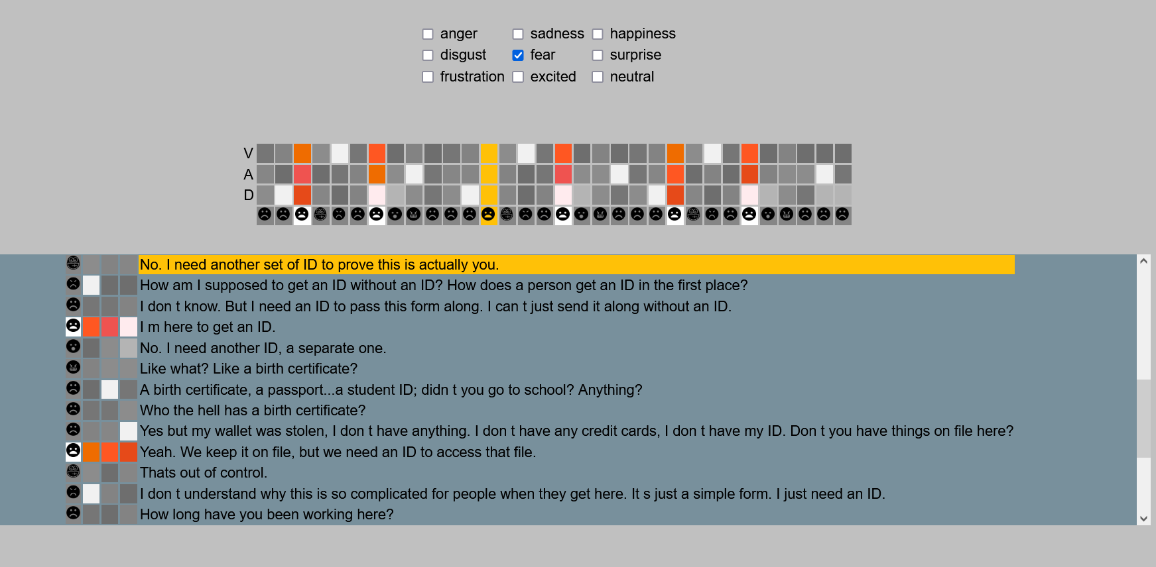


Emotion visualizer
Emotion: an emotion can be represented under 2 forms:
with categorical emotions like Anger, Happiness, sadness,...,
with a triplet of 3 VAD numbers ranging from 0 to 4 : (Valence, Arousal, Dominance).
Context: In a company, meetings are audio recorded. An AI model transcripts the audio to text and characterises every sentence with an emotion (categorical or VAD).
Problematic: Users (managers, HR people,..) need an easy way to :
• have an overview of the emotions expressed throughout the whole meeting
• be able to visualize only the emotions they are interested in,
• read the text of the sentences where the emotions they are interested in, have been expressed.
The meeting horizontal display enables the user to have an overview of the meeting.
Each column corresponds to a sentence .
Clicking on one column will position the corresponding sentence in the bottom panel.
The filter panel enables the user to make the emotion he is interested in to pop up .
VAD emotions are represented as colored squares varying from white (0) to orange (4).
Categorical emotions are represented with emoticons like : or
In the bottom panel, the user can scroll through the meeting text.
I-Tang HIU Jean-Luc PHEUNG Joachim CARVALLO Alan ZAKAR

